Slide 1

SurWei
Alice Abillu
Jacob Shields
Sreedhar Jalasutram

Slide 2



Agenda
Summary
Approach
Results
Next Steps

Slide 3




Summary
Project SurWei involves in creating a Survey, distributing the survey to a group of respondents, and recording the responses on an Ethereum blockchain.

Slide 4
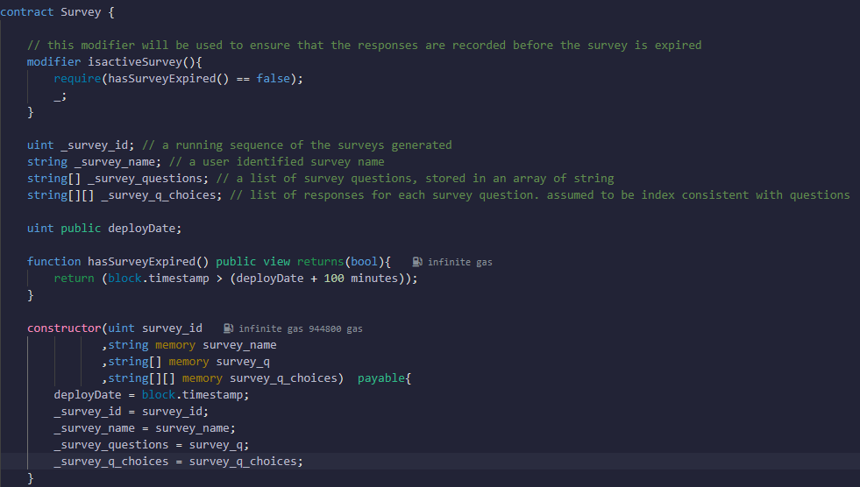
Approach
Identify Survey Data structure
Survey Identifier: A sequence generated value that uniquely identifies a survey
Survey Name: A user assigned title value of the survey
Questions: A series of questions that the conductor includes in the survey
Choices: A set of choices applicable for a question, indexed by values A, B, C and D
Determine the components involved
Survey Generator : Using a factory pattern, the smart contract generates surveys on-demand
Survey Responder: A mechanism where users on the blockchain could respond to a survey
Survey Results: A report of the survey, question and choices, and the responses recorded on that survey
User interface or a CLI to interact with the survey

Slide 5
Approach
Techniques
Survey Deployer smart contract on the block chain acts as a server of surveys
Used Pandas to read one or more surveys from an Excel based spreadsheet
Survey is a transaction on the blockchain associated with an address
Responses were generated using random choice selections using local Ganache Accounts
dApp using web3py used to interact with the Survey Deployer and with Survey on the block chain
Opportunities
Develop user interface to facilitate survey creation
App to access a specific survey and respond
Real time analytics reporting on the survey responses

Slide 6
Demonstration
Survey Generator
Survey
Responding to a Survey
Publishing results

Slide 7
Next Steps
Implement features
Not more than one survey response per address
A way to authenticate that the responder is a human
Publish results only after the survey timeline expired

Slide 8


Thank You
Alice Abillu, Jacob Shields, Sreedhar Jalasutram
Github: https://github.com/sjalasutram/FinTechProject3

